Slide 1
SECURE DATA HIDING IN IMAGE USING STEGNOGRAPHY
CAPSTONE PROJECT
Presented By: Batti Sai teja
Student Name : Batti Sai teja
College Name & Department : B V Raju Institute of Technology Electrical and Electronics Engineering

Slide 2
OUTLINE
Problem Statement
Technology used
Wow factor
End users
Result
Conclusion
Git-hub Link
Future scope

Slide 3
Problem Statement
Protect sensitive information from unauthorized access.
Hide messages inside images without detection.
Ensure secure transmission of confidential data.
Enable easy extraction of hidden data when needed.

Slide 4
Technology used
Python
PIL (Pillow) for image processing
NumPy for data handling
OpenCV for visualization

Slide 5
Wow factors
Uses Least Significant Bit (LSB) method for high secrecy.
Hides data without noticeable image quality loss.
Can work with multiple image formats.
Easy-to-use Python script for encoding and decoding.

Slide 6
End users
Cybersecurity professionals
Journalists and whistleblowers
Military and intelligence agencies
Anyone needing secure communication

Slide 7
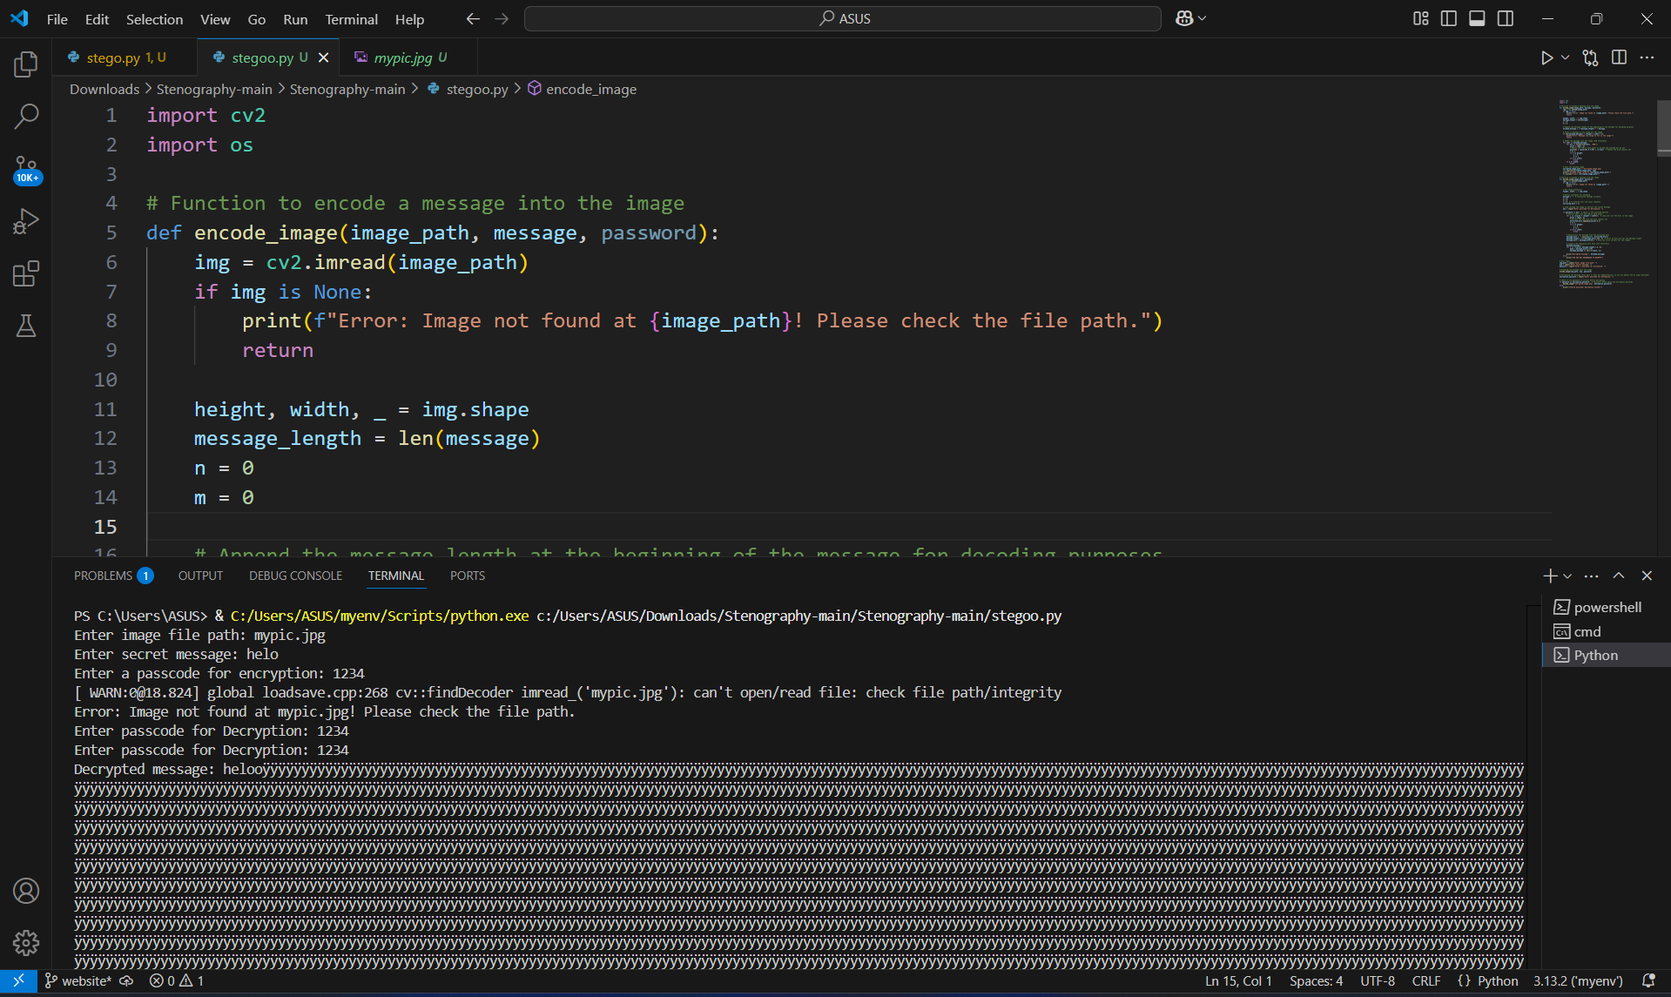
Results
Below are screenshots of the encoding and decoding process:

Slide 8
Conclusion
This project successfully demonstrates secure data hiding using steganography. It enables confidential communication by embedding messages into images while maintaining their quality.

Slide 9
GitHub Link
Find the complete project with a README file here:
https://github.com/Saitejabatti/steg.git

Slide 10
Future scope(optional)
Implement encryption for added security.
Extend the technique to audio and video files.
Develop a GUI-based tool for user-friendly interaction.

Slide 11
THANK YOU

